Slide 1
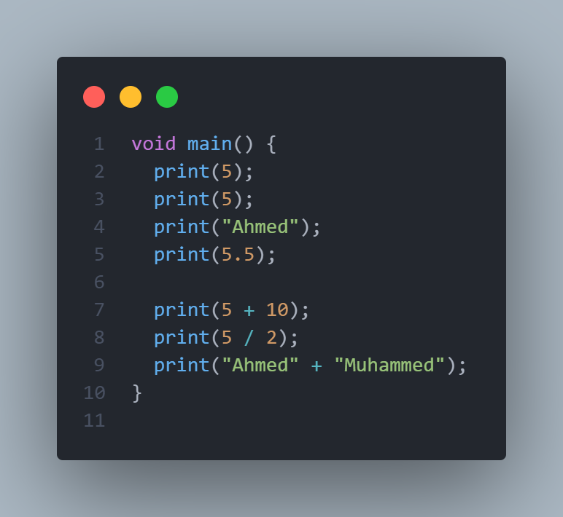
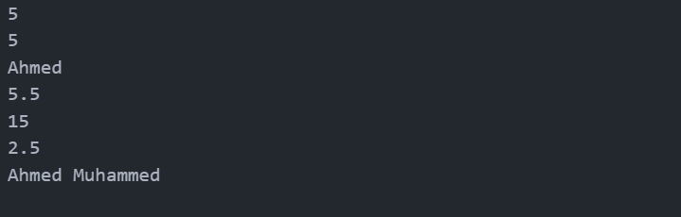
Commands
We knew that a programming language is a way to give computer some instructions, and just like any language there are predefined keywords that can help us to achieve something we want
To something on the screen, we can you use what is a command or a method, like the print() method

Slide 2
Void main
void main is called the entry point of the app, or the starting point, the dart compiler that is responsible to translate the commands into a machine code, the compiler executes the code line by line sequentially, it’s like writing on a notebook, you start to write on the first white paper and not on the cover, so the white paper is the starting point

Slide 3
Variables and data types
We used print() show something on the screen, that is called the output, now we want to take something from the user, but where would we put it?
We use variables to store data that we fetch from the
Variables are stored in memory or RAM, we can think of the ram as a very tall desk that has drawers, we give each drawer a name and more important we say that each drawer contain which type of data, like we could have a drawer that holds pencils, another one to hold papers and another for money, that ordering is called data type, we say we want to store a 5 in variable called number that has the integer data type.

Slide 4
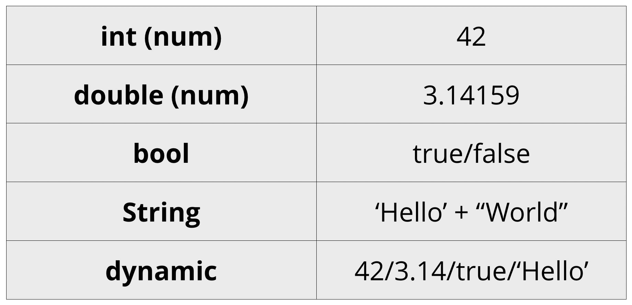
data types
Photo contains primitive data types in
dart
int is used to hold whole numbers
double is used to hold decimals
bool is used to hold, two values true and false
When you ask a simple question like are you 18 years old or older or not?, if yes then that value is true, if no then that value is false
String is used to store text, or simply anything between double “” or single ‘’ quotes
“Muhammed”
“5”
We see five here is considered as String
dynamic is used to store any value, it’s like a drawer that is used to store anything
It’s not preferred to use dynamic all the time,

Slide 5
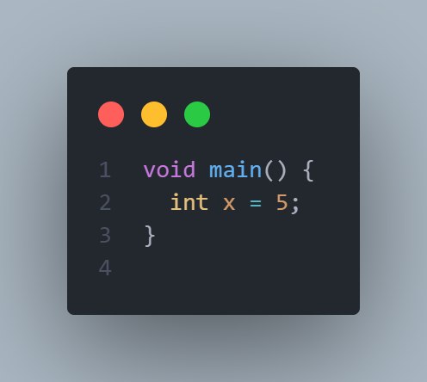
Declaring variables with data types
It’s very important to know what is the syntax to define a varialbe
Line two shows the syntax for just that
int is the data type we want to store in memory
As we said we need to give each drawer in the desk
Or in that case each variable a name to be able to use
It later in other part of the code
= this is called the assignment operator
5 this is the value we wan to store,
values should be of the same data type we defined our variable to be
Semi colon or ; at the end of each line is mandatory, it’s like ending a question, we use ? Question mark
Final form
dataType variableName = value;

Slide 6
Variables naming rules
The are rules you must follow when writing a variable name
You can’t start variable names with numbers, but you can user numbers anywhere in the variable
1myname Error
myNa1me OK
You can’t use any preserved words like if, null, for, int
you can’t use special characters like @, !, %, but you can use underscore _

Slide 7
Variables naming conventions
There are standard rules between the community of each programming language on how to write variables names, the compiler won’t complain but get used to them since you will deal with other people code in the future
When we write a variable name that consist of only one word, it should be lower case, but if we use a variable name that has more than one name we use camelCase
Camel case is used to name variables that has multiple words, you each word is simply lowercased and the first letter in each subsequent word is uppercase, like the following examples
String firstName = “Muhammed”;
String lastName = “Ahmed”;

Slide 8
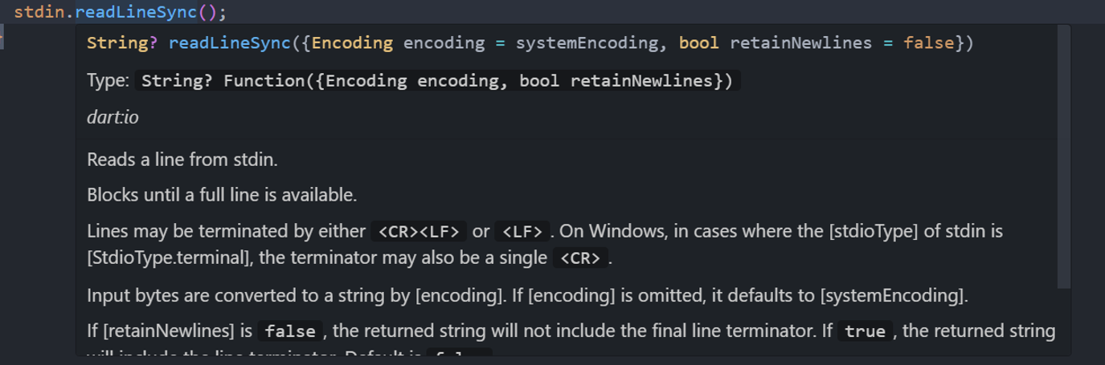
Taking input from the user
After printing and storing variables, we need to get a value from the user
The command that is used to read an input from the user is stdin.readLineSync()
stdin.readLineSync()
It’s important to hover over each
Method and know what is the return type
Of that method, know what parameters
It receives and also read what it does
It all seems enigmatic for now, but with
you will know the process, you will see that it returns String?, just ignore the ? , we will talk about it in much details later,
If you want to get a glimpse of what a String? Is, just search for nullables on google

Slide 9
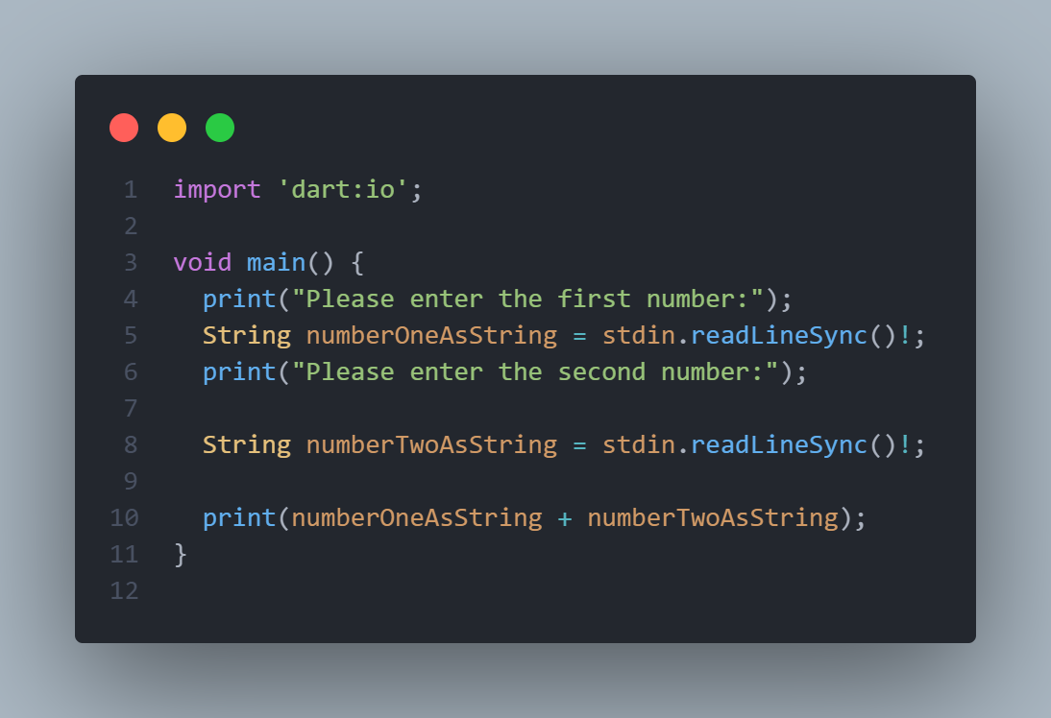
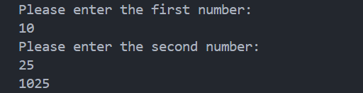
Taking input from the user
Let’s take two numbers from the user and
them, we read line from the user on line 5
and on line 8, again just ignore the ! For now
After taking the two numbers from the user, say
10 and 25, when we try to add them, we get 1025
while the expected is 35
The reason is a concept called concatenation
instead of adding, Dart concatenates Strings or in
other words it joins these two or more strings togther
Dart still reads the values you entered, 10 and 25
as Strings not as numbers.
The question is, how to change these inputs to numbers or integers?
This is a concept called, type casting

Slide 10
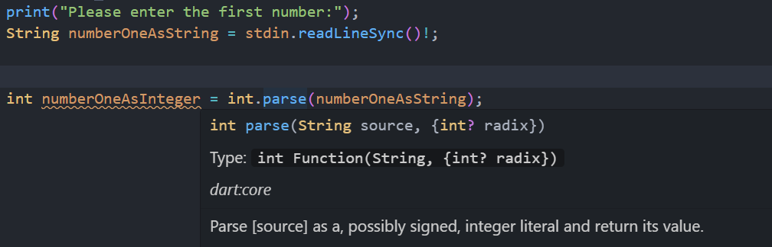
Type casting
It’s a way to convert from one data type to another, like from String to integer
the function that is responsible for that is int.parse()
Int.parse()
Just like we did with the stdin.readLineSync(), we hover of this function and see what it receives and what it returns, we see that it receives and String and returns an int, just like what we need

Slide 11
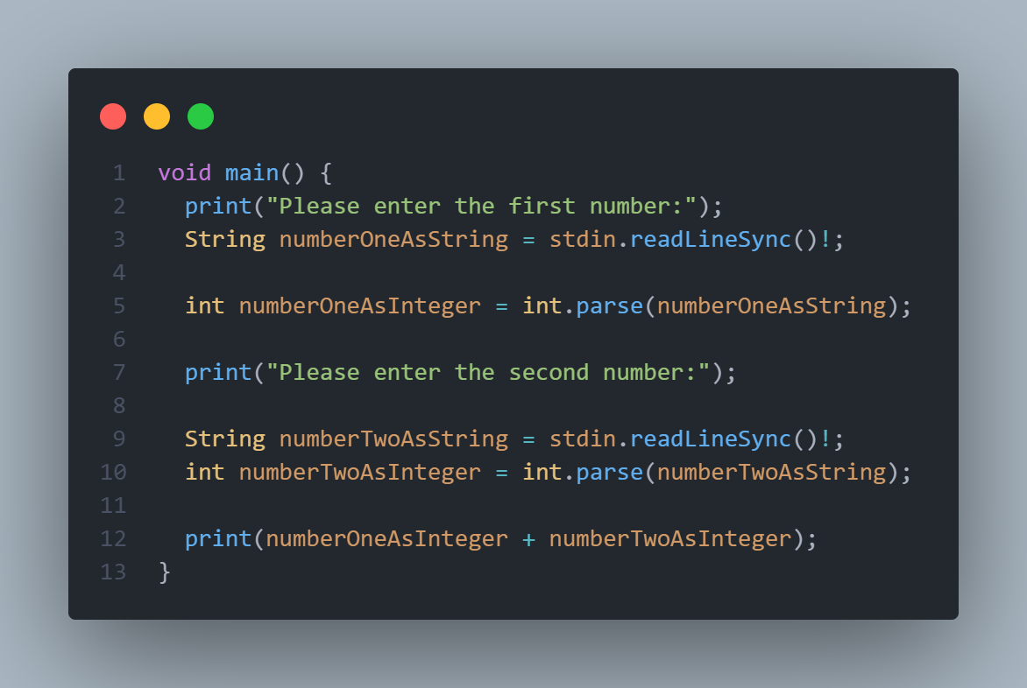
Final addition code

Slide 12
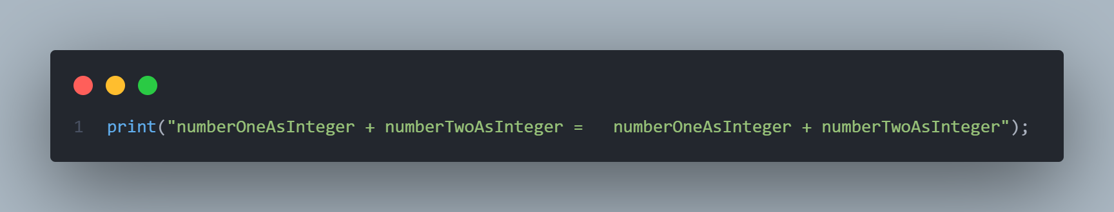
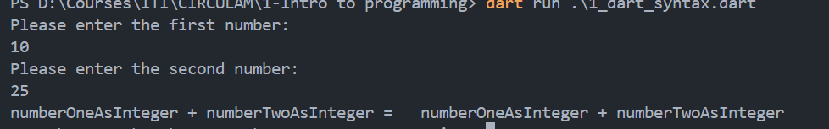
String interpolation
It would be better if we printed a message to the user saying showcasing the entire operations, if we try to print the message in the first picture we just get print these messages, not the actual value, in this case we use String interpolation, to format the message more clearly
String interpolation are just two sympols
$ and ${}

Slide 13
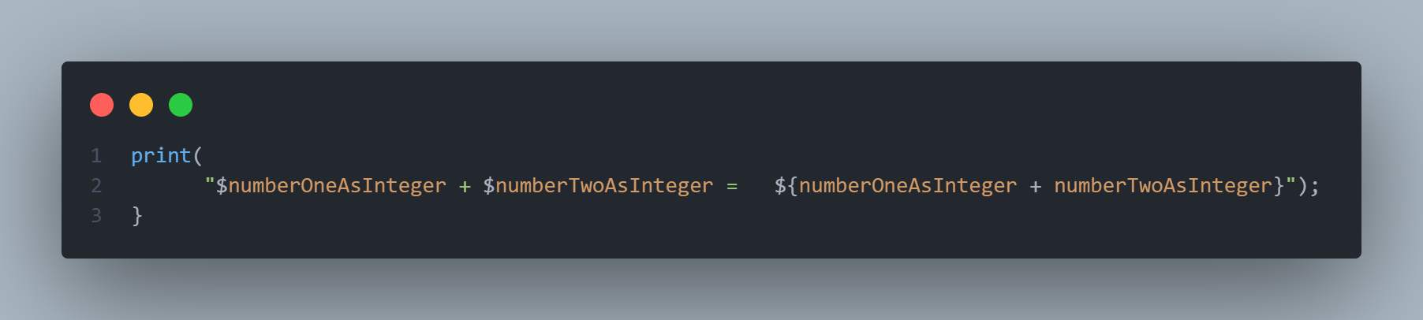
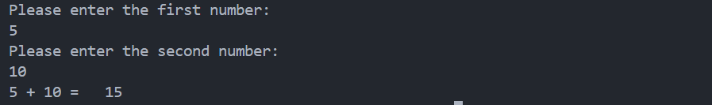
String interpolation
In $numberOneAsIntger, I’m telling him to use the actual number the user entered, same goes for $numberTwoAsIntegers
To actually write the operation after the = sign we use the ${, to indicate that this is an operation

Slide 14
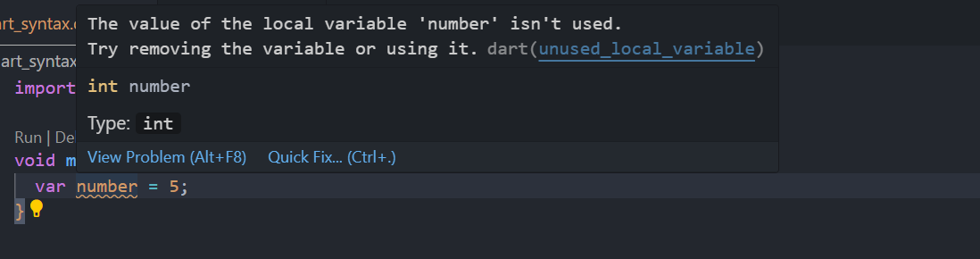
Type inference using var, const and final
Sometimes you may not explicitly specify, the data type of a variable, instead we leave that job for the compiler to decide, this is called type inference, the firs keyword to achieve that is var
as you can see, the compiler is smart enough to determine the value type of the number variable that it’s an integer

Slide 15
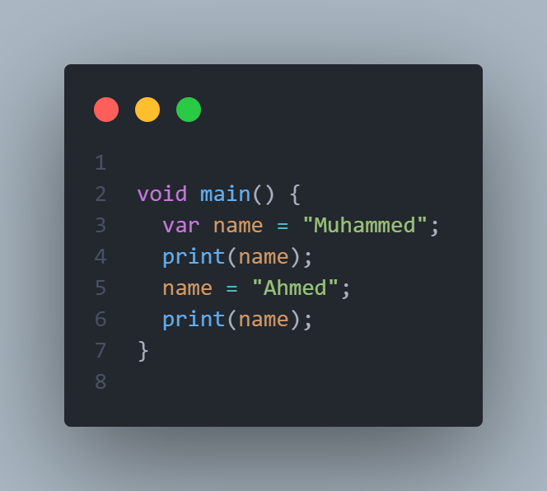
Type inference using var, final and const
final and const vs var
Just as var, final and const achieve the same thing, the only difference is that in var you can change the variable or reassign the values in future, but for const and final you can’t

Slide 16
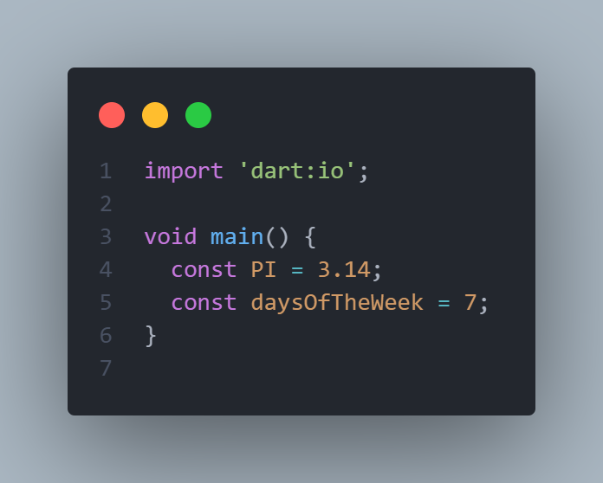
final vs const
As the name suggests final and const which stands for constants can’t be changed, the most important difference are
const
The value of constants are determined at compile time, which are values that I specify by hand when I write code
Like the PI value, days of the week
Months of the year and so on

Slide 17
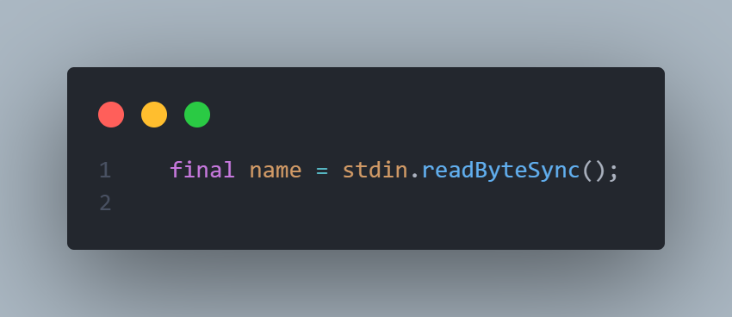
final vs const
final
This can be used in both runtime and compile time, like the code below, name is automatically
gets assigned the value I receive
from the user at runtime

